Slide 1
FitCoach AI: AI-Powered Virtual Fitness Coach
IBM AICTE PROJECT
Presented By:
Student name : MD FAIZAN
College Name & Department : Brainware University, CSE(AI-ML)

Slide 2
OUTLINE
Problem Statement
Technology used
Wow factor
End users
Result
Conclusion
Git-hub Link
Future scope
IBM Certifications

Slide 3
Problem Statement
In today’s busy world, many people find it difficult to maintain a healthy lifestyle. Lack of personalized fitness guidance, limited time, and low motivation create barriers. Traditional fitness solutions often require expensive memberships, rigid schedules, or face-to-face sessions, which many cannot access or sustain. This leaves a wide gap for convenient, affordable, and adaptive fitness support tailored to individual needs.
Proposed Solution:
FitCoach AI is an intelligent virtual fitness coach built using IBM watsonx.ai and IBM Cloud services. It offers on-demand, personalized workout plans, nutrition suggestions, and motivation through a conversational AI interface. This no-code agent understands user preferences and fitness goals, making healthy living easier, more accessible, and enjoyable for everyone, anytime and anywhere.

Slide 4
Technology used
IBM watsonx.ai Studio We used this platform because it provides powerful no-code tools and AI agent building features. It allowed us to create and customize FitCoach AI easily without writing complex code.
IBM Agent Lab This helped us build the AI agent with user-friendly drag and drop interfaces and integrate custom tools. It makes setting up conversational flows and knowledge bases straightforward.
IBM Granite Foundation Model Granite is the language model behind the agent. It understands user questions naturally and helps generate helpful, clear, and human-like responses.
Custom Python Tools Python was used for creating specialized tools like the Macronutrient Split Calculator, which handle personalized calculations effectively.
IBM Cloud Object Storage We stored fitness documents, diets, and workout plans here. This made it easy for the AI to access and ground answers in trusted, relevant content.
Vector Search and Knowledge Grounding This technology indexes uploaded files so the agent can search through them effectively and pull-out accurate information during conversations.

Slide 5
IBM cloud services used
IBM watsonx.ai Studio This was the main workspace where the entire AI agent was designed and managed. It brought together all the tools and features needed to create a smart, responsive assistant without writing lots of code.
IBM Agent Lab We relied on Agent Lab to build the conversational experience. Its no-code setup let us craft natural dialogues, add custom tools, and link various features simply by configuring blocks and workflows.
Granite Foundation Model (granite-3-3-8b-instruct) We used the IBM provided Granite model, version 3.3, as the core language model. It understands natural language really well and produces helpful, clear, and contextually relevant responses.
IBM Cloud Object Storage We used this storage service to safely hold our documents, workout routines, and nutrition guides. This made it possible for the AI to retrieve and use trustworthy content on demand.

Slide 6
Wow factors
FitCoach AI is not just another chatbot or basic workout assistant. It feels like you have a supportive coach and nutritionist in your pocket, ready to help at any moment.
The true magic of FitCoach AI lies in how it makes advanced technology feel simple and inviting. Right from the first interaction, users can ask questions about their fitness, nutrition, or motivation in their own words. There is no need to scroll through complicated menus or apps. If you wake up feeling unsure how to start your healthy routine, you can simply chat with FitCoach AI as if you are texting a friend.
What makes this solution special is the instant access to expert advice that adapts to each person. The AI listens to your goals and how you are feeling and draws from trusted, grounded resources to offer personalized guidance. Whether someone needs a quick morning workout, ideas for a healthier lunch, or just a reason to get moving, FitCoach AI is always ready with a caring and encouraging response.
Unlike traditional fitness apps that can feel overwhelming or impersonal, FitCoach AI meets you where you are, anytime. You do not need a gym membership, special equipment, or even technology skills. The only thing you need is a question or a little curiosity about how to live healthier.
Behind the scenes, FitCoach AI uses state-of-the-art AI models from IBM to ensure every answer is accurate, helpful, and easy to understand. Yet, users only see the smooth, conversational experience. It never feels robotic or scripted, just genuinely helpful.
In short, FitCoach AI lowers the barriers to better health. It brings personalized fitness support out of the gym and into everyday life. Wherever you are in your health journey—just starting out, stuck in a rut, or looking for that next challenge, FitCoach AI offers practical support and motivating advice to help you take the next step confidently.

Slide 7
End users
FitCoach AI is designed for anyone who wants to take better care of their health, no matter their background or experience. It is especially helpful for:
Students who are looking for quick health advice between classes and assignments.
Busy professionals struggling to find time for the gym but who still want to stay active and feel good.
Beginners who feel lost about where to start or get overwhelmed by complicated fitness apps.
Fitness enthusiasts searching for motivation, fresh workout ideas, or easy meal suggestions.
Anyone who feels stuck or discouraged along their health journey and needs a friendly push to keep going.
No matter your age, lifestyle, or current fitness level, FitCoach AI offers a supportive hand. The agent works right in your everyday routine, so you can ask questions and get trustworthy advice exactly when you need it.

Slide 8
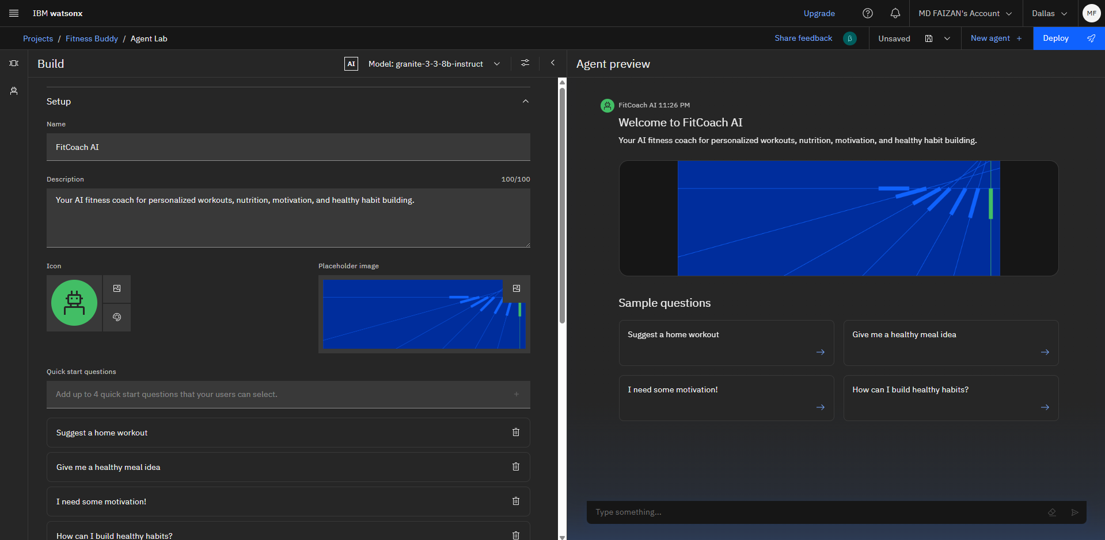
Results

Slide 9
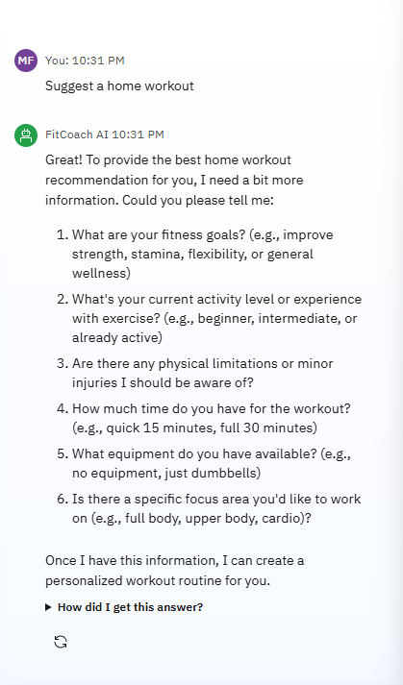
Results

Slide 10
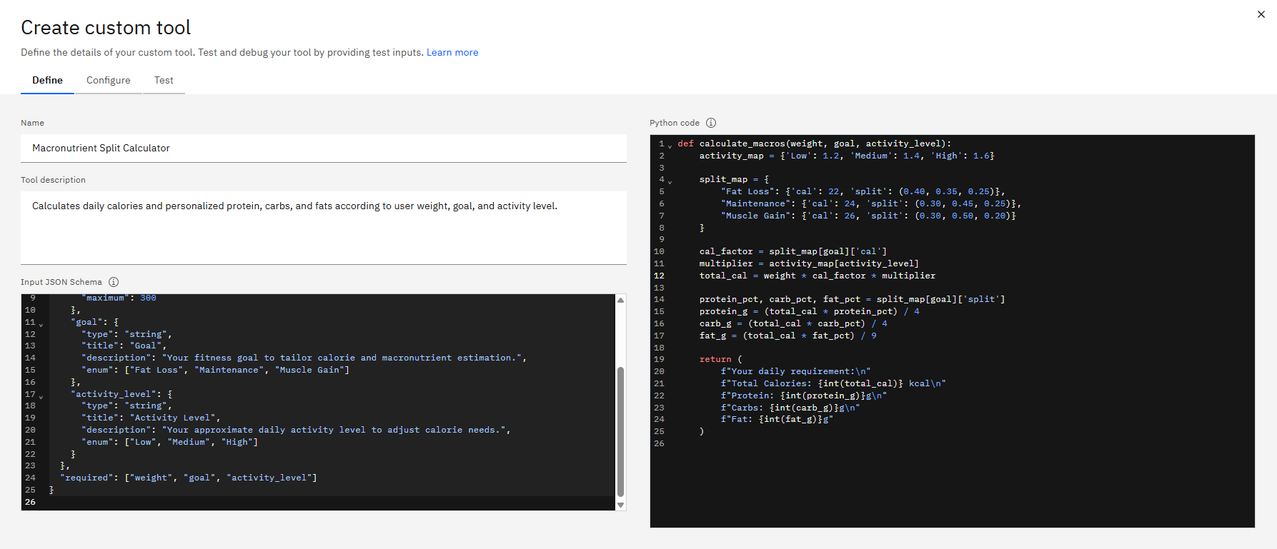
Results
Custom Tool: Macronutrient Split Calculator

Slide 11
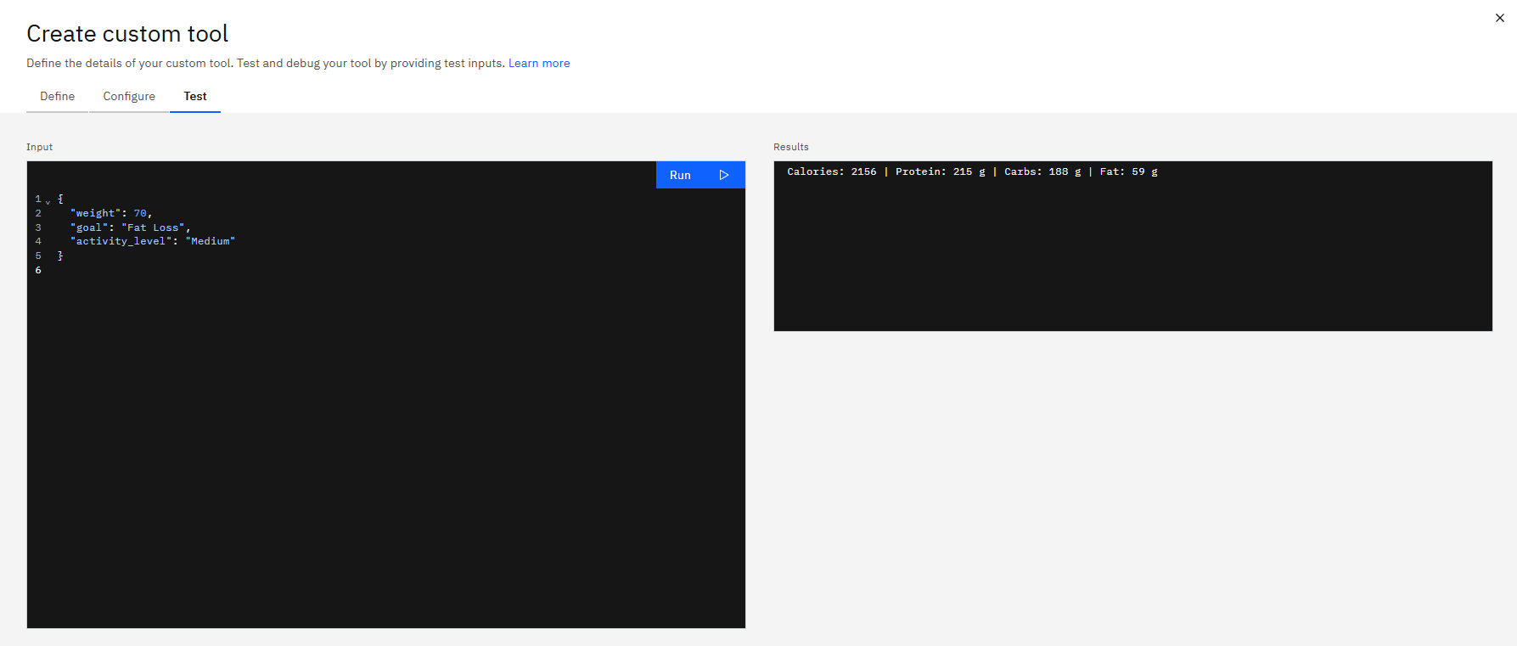
Results
Custom Tool: Macronutrient Split Calculator Test

Slide 12
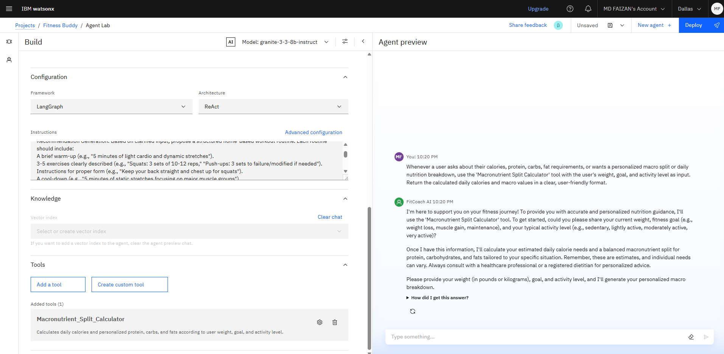
Results

Slide 13
Conclusion
The agent can generate reports, suggest hypotheses, and even draft sections of research papers.
It saves time by automating repetitive tasks like citation management and data extraction.
Research Agents enhance efficiency, accuracy, and innovation in both academic and industrial R&D.

Slide 14
Future scope
Multilingual Research Support
Voice-Activated Research Assistant
Real-Time Collaboration Features
Research Gap and Novel Topic Identification
Integration with Publishing Platforms
AI-Assisted Paper Drafting

Slide 15
IBM Certifications
Screenshot/ credly certificate( getting started with AI)

Slide 16
Attach your RAG LAB certificate here

Slide 17
Git hub lik : https://github.com/AswiniKumar55/Nutrion_agent

Slide 18
GitHub Link
Make sure that there should be readme file

Slide 19
THANK YOU

